Slide 1

Computer Organization And Architecture
CSE-209
Lecture - 04
Al Bashir
Lecturer, Dept. of CSE
Dhaka International University

Slide 2
Content
Computer Function
Instruction Fetch and Execute
Interrupts
Interconnection Structure
Bus Interconnection

Slide 3
What is a program?
A sequence of steps
For each step, an arithmetic or logical operation is done
For each operation, a different set of control signals is needed

Slide 4
What is a program?
A computer program is a collection of instructions that performs a specific task when executed by a computer. A computer requires programs to function.

Slide 5
Function of Control Unit
For each operation a unique code is provided
e.g. ADD, MOVE
A hardware segment accepts the code and issues the control signals
We have a computer!

Slide 6
Function of Control Unit : Components
The Control Unit and the Arithmetic and Logic Unit constitute the Central Processing Unit
Data and instructions need to get into the system and results out
Input/output
Temporary storage of code and results is needed
Main memory

Slide 7
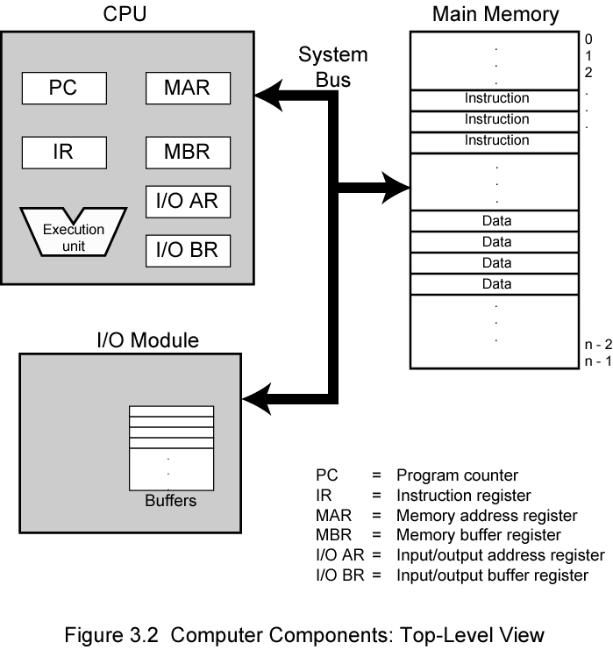
Computer Components: Top Level View

Slide 8
Instruction Fetch and Execute
At the beginning of each instruction cycle, the processor fetches an instruction from memory.
In a typical processor, a register called the program counter (PC) holds the address of the instruction to be fetched next.
Unless told otherwise, the processor always increments the PC after each instruction fetch so that it will fetch the next instruction in sequence (i.e., the instruction located at the next higher memory address).

Slide 9
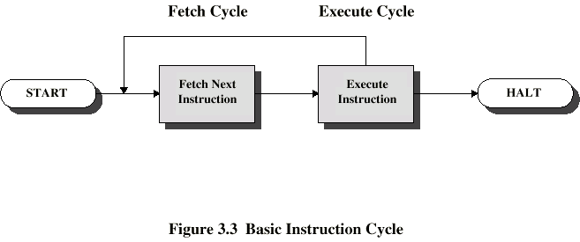
Instruction Cycle
Two steps:
Fetch
Execute

Slide 11
Fetch Cycle
Program Counter (PC) holds address of next instruction to fetch
Processor fetches instruction from memory location pointed to by PC
Increment PC
Unless told otherwise
Instruction loaded into Instruction Register (IR)
Processor interprets instruction and performs required actions

Slide 12
Execute Cycle
Processor-memory
data transfer between CPU and main memory
Processor I/O
Data transfer between CPU and I/O module
Data processing
Some arithmetic or logical operation on data
Control
Alteration of sequence of operations
e.g. jump
Combination of above

Slide 13
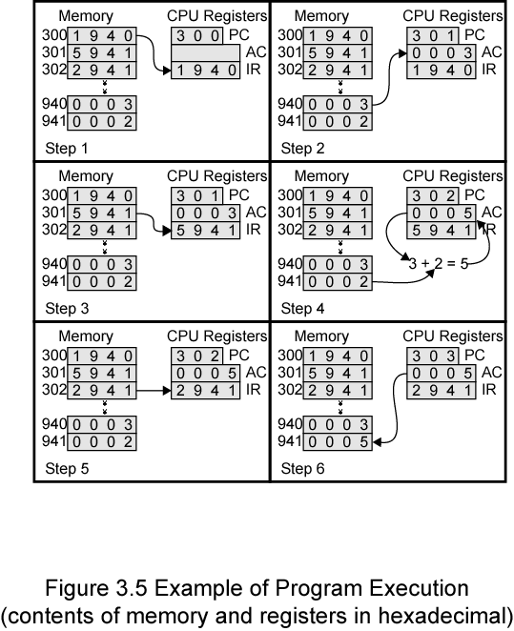
Example of Program Execution

Slide 14
Example of Program Execution cont…
Program counter (PC) = Address of instruction
Instruction register (IR) = Instruction being executed
Accumulator (AC) = Temporary storage
0001 = Load AC from memory
0010 = Store AC to memory
0101 = Add to AC from memory

Slide 15
Example of Program Execution cont…
The program fragment shown adds the contents of the memory word at address 940 to the contents of the memory word at address 941 and stores the result in the latter location. Three instructions, which can be described as three fetch and three execute cycles, are required:

Slide 16
Example of Program Execution cont…
1. The PC contains 300, the address of the first instruction. This instruction (the value 1940 in hexadecimal) is loaded into the instruction register IR and the PC is incremented. Note that this process involves the use of a memory address register (MAR) and a memory buffer register (MBR). For simplicity, these intermediate registers are ignored.
2. The first 4 bits (first hexadecimal digit) in the IR indicate that the AC is to be loaded. The remaining 12 bits (three hexadecimal digits) specify the address (940) from which data are to be loaded.
3. The next instruction (5941) is fetched from location 301 and the PC is incremented.
4. The old contents of the AC and the contents of location 941 are added and the result is stored in the AC.
5. The next instruction (2941) is fetched from location 302 and the PC is incremented.
6. The contents of the AC are stored in location 941.

Slide 17
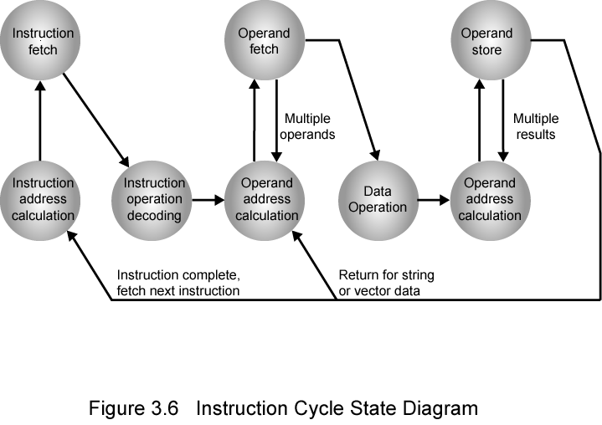
Instruction Cycle State Diagram

Slide 18
Instruction Cycle State Diagram
Instruction address calculation (iac): Determine the address of the next instruction to be executed. Usually, this involves adding a fixed number to the address of the previous instruction.
Instruction fetch (if): Read instruction from its memory location into the processor.
Instruction operation decoding (iod): Analyze instruction to determine type of operation to be performed and operand(s) to be used.
Operand address calculation (oac): If the operation involves reference to an operand in memory or available via I/O, then determine the address of the operand.
Operand fetch (of): Fetch the operand from memory or read it in from I/O.
Data operation (do): Perform the operation indicated in the instruction.
Operand store (os): Write the result into memory or out to I/O.

Slide 19
Interrupts
Mechanism by which other modules (e.g. I/O) may interrupt normal sequence of processing
Program
e.g. overflow, division by zero
Timer
Generated by internal processor timer
Used in preemptive multi-tasking
I/O
from I/O controller
Hardware failure
e.g. memory parity error

Slide 20
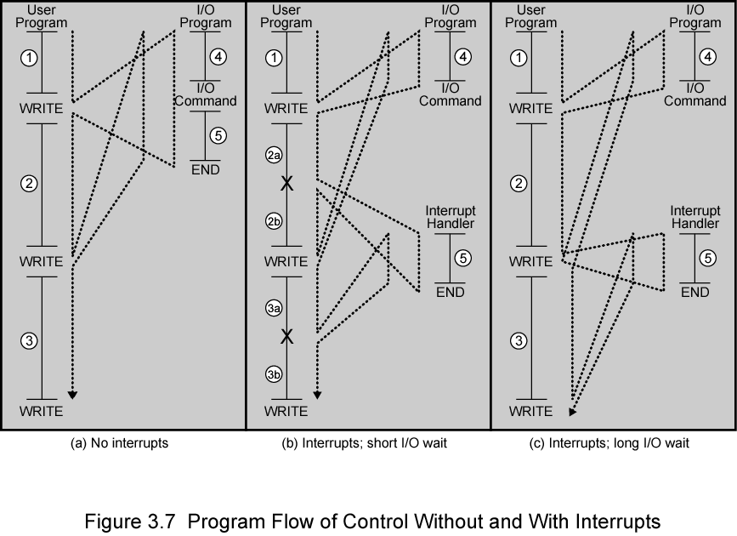
Interrupts : Program Flow Control

Slide 21
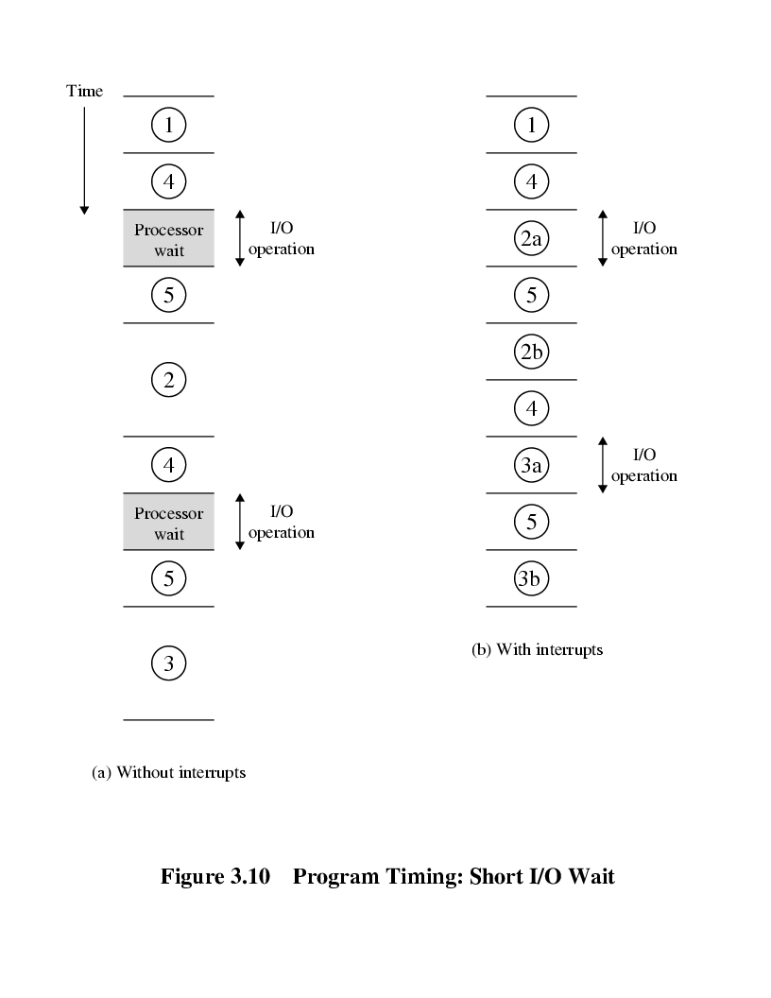
Program Timing : Short I/O Wait

Slide 22
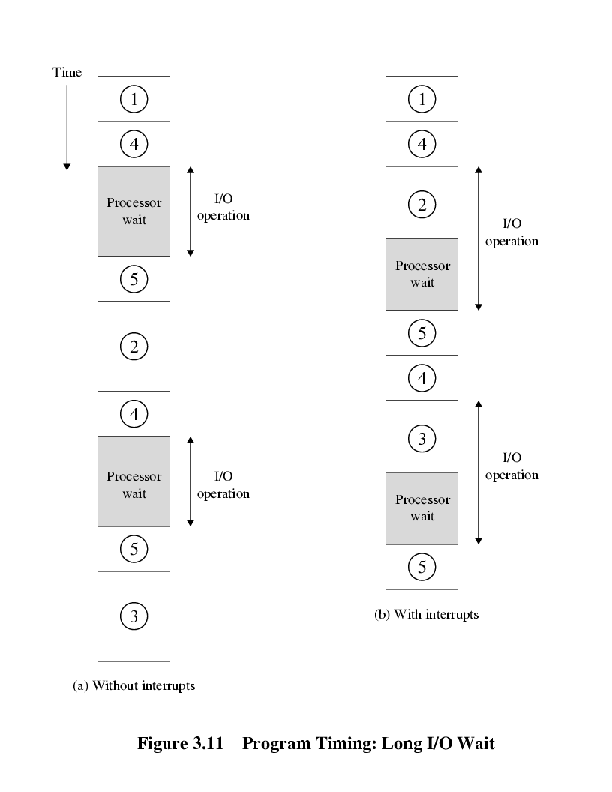
Program Timing : Long I/O Wait

Slide 23
Interrupts Cycle
Added to instruction cycle
Processor checks for interrupt
Indicated by an interrupt signal
If no interrupt, fetch next instruction
If interrupt pending:
Suspend execution of current program
Save context
Set PC to start address of interrupt handler routine
Process interrupt
Restore context and continue interrupted program

Slide 24
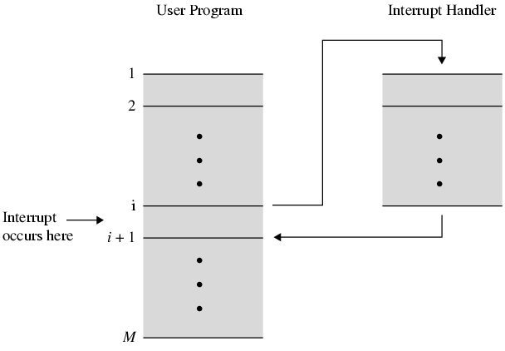
Transfer of Control via Interrupts

Slide 25
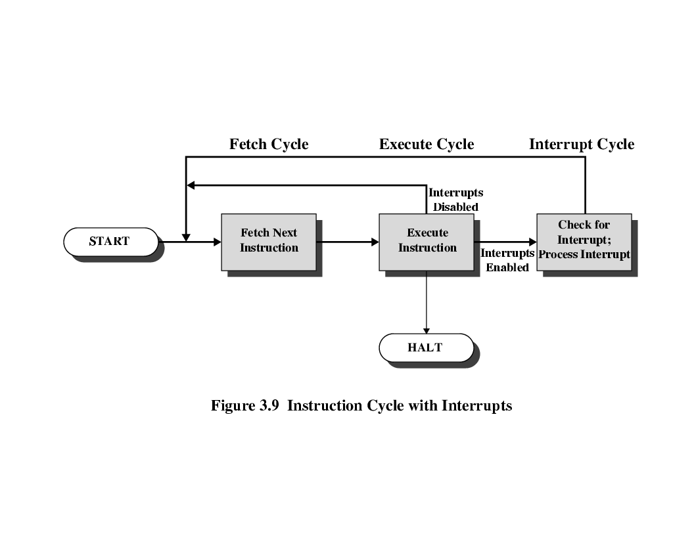
Instruction Cycle with Interrupts

Slide 26
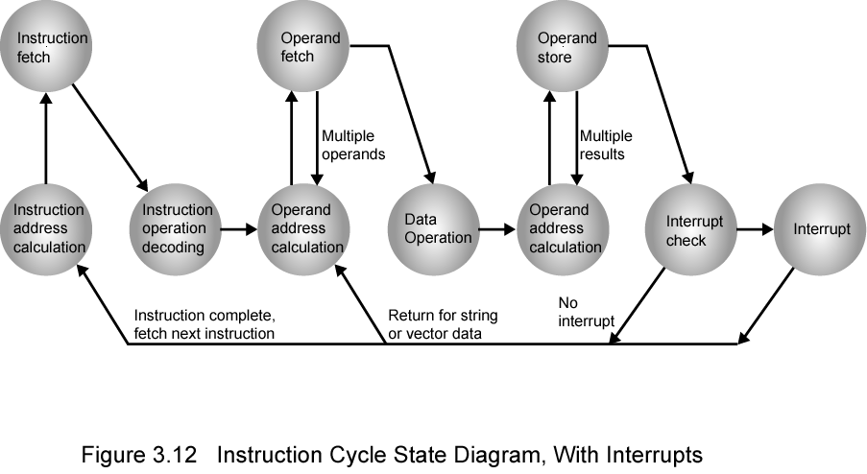
Instruction Cycle (with Interrupts) - State Diagram

Slide 27
Connecting
All the units must be connected
Different type of connection for different type of unit
Memory
Input/Output
CPU

Slide 28
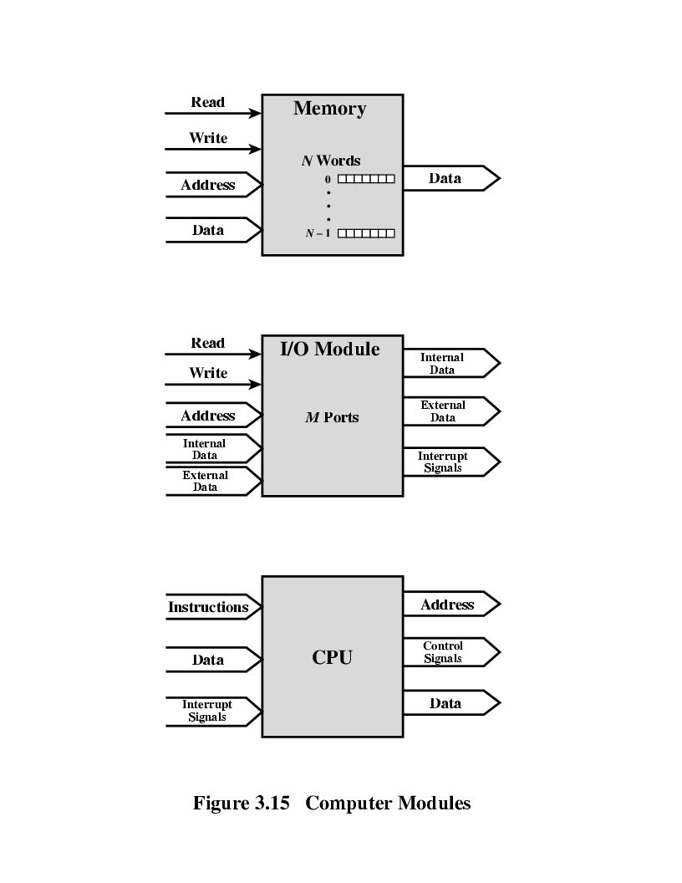
Connecting : Computer Modules

Slide 29
Memory Connection
Receives and sends data
Receives addresses (of locations)
Receives control signals
Read
Write
Timing

Slide 30
Input/Output Connection
Similar to memory from computer’s viewpoint
Output
Receive data from computer
Send data to peripheral
Input
Receive data from peripheral
Send data to computer

Slide 31
Input/Output Connection Cont..
Receive control signals from computer
Send control signals to peripherals
e.g. spin disk
Receive addresses from computer
e.g. port number to identify peripheral
Send interrupt signals (control)

Slide 32
CPU Connection
Reads instruction and data
Writes out data (after processing)
Sends control signals to other units
Receives (& acts on) interrupts

Slide 33
Inter Connection Must Support….
Memory to processor: The processor reads an instruction or a unit of data from memory.
Processor to memory: The processor writes a unit of data to memory.
I/O to processor:The processor reads data from an I/O device via an I/O module.
Processor to I/O: The processor sends data to the I/O device.
I/O to or from memory: For these two cases, an I/O module is allowed to exchange data directly with memory, without going through the processor, using direct memory access (DMA).

Slide 34
Buses
There are a number of possible interconnection systems
Single and multiple BUS structures are most common
e.g. Control/Address/Data bus (PC)
e.g. Unibus (DEC-PDP)

Slide 35
What is Bus?
A communication pathway connecting two or more devices.
A bus is a communication pathway connecting two or more devices.
Typically, a bus consists of multiple communication pathways, or lines. Each line is capable of transmitting signals representing binary 1 and binary 0. Over time, a sequence of binary digits can be transmitted across a single line. Taken together, several lines of a bus can be used to transmit binary digits simultaneously (in parallel).
For example, an 8-bit unit of data can be transmitted over eight bus lines.

Slide 36
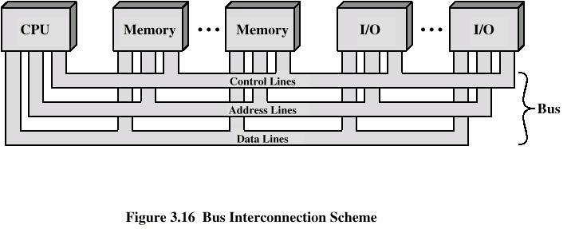
Bus Interconnection Scheme

Slide 37
Data Bus
The data lines provide a path for moving data among system modules. These lines, collectively, are called the data bus. The data bus may consist of 32, 64, 128, or even more separate lines, the number of lines being referred to as the width of the data bus. Because each line can carry only 1 bit at a time, the number of lines determines how many bits can be transferred at a time.
Carries data
Remember that there is no difference between “data” and “instruction” at this level
Width is a key determinant of performance
8, 16, 32, 64 bit

Slide 38
Address Bus
The address lines are used to designate the source or destination of the data on the data bus. For example, if the processor wishes to read a word (8, 16, or 32 bits) of data from memory, it puts the address of the desired word on the address lines.
Clearly, the width of the address bus determines the maximum possible memory capacity of the system.
Identify the source or destination of data
e.g. CPU needs to read an instruction (data) from a given location in memory
Bus width determines maximum memory capacity of system
e.g. 8080 has 16 bit address bus giving 64k address space

Slide 39
Control Bus
The control lines are used to control the access to and the use of the data and address lines. Because the data and address lines are shared by all components, there must be a means of controlling their use.
Control signals transmit both command and timing information among system modules.
Control and timing information
Memory read/write signal
Interrupt request
Clock signals

Slide 40
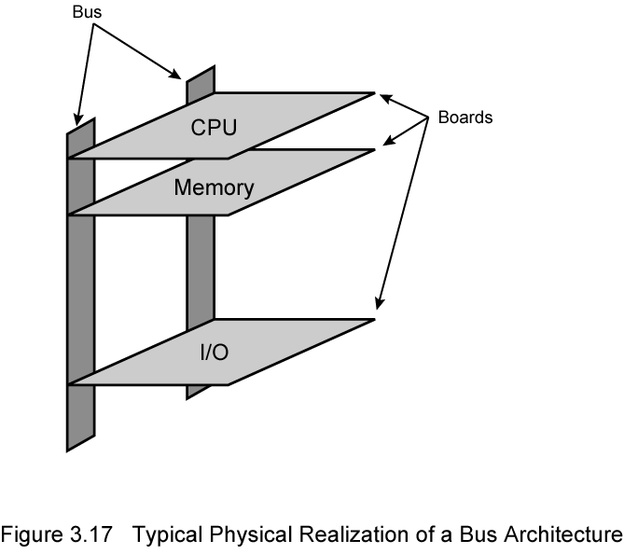
Physical Realization of Bus Architecture

Slide 41
Bus Types
Dedicated
Separate data & address lines
Multiplexed
Shared lines
Address valid or data valid control line
Advantage - fewer lines
Disadvantages
More complex control
Ultimate performance

Slide 42
Question??

Slide 43
Thanks

